Slide 1

Performance Evaluation for Computer Systems and Networks
Analysis of the protocol
Epidemic Broadcast
Antonio Di Tecco – Gabriele Martino – Maurizio Pulizzi

Slide 2
Epidemic broadcast – Overview and Modeling
MSG
Network setup:
Static, flat and multi-hop
Time discrete, one message fit in a slot
Nodes are located with a uniform randomness
Retransmission probability is given by a
Bernullian distribution
Performance indexes:
Broadcast time
Coverage%
Collisions number
SM & COUNTER = 1
SM & MSG UNSENT
NOT INFECTED
INFECTED
*SM &
COUNTER > 1
SENT
IDLE
* SM = Self message
Antonio Di Tecco Gabriele Martino Maurizio Pulizzi
2

Slide 3
Preliminary analisys
Affecting factors:
Floor size (X,Y)
Ratio of the two edge of the floor R_{X|Y}
Quantity of nodes N
Retransmission probability P_{r}
Starter node position
Calibration:
Radius of transmission R = 30m
Perfectioning of a scenario for multi hopping
Antonio Di Tecco Gabriele Martino Maurizio Pulizzi
3

Slide 4
The room
Scenario:
Dimensions: 125x250 meters
Factors: Probability of retrasmissions and number of nodes
Results:
Minimum density required
For low P_{r} total coverage is obtained
Hight P_{r} require more density
Hight P_{r} converges to lower coverage percentages
Antonio Di Tecco Gabriele Martino Maurizio Pulizzi
4

Slide 5
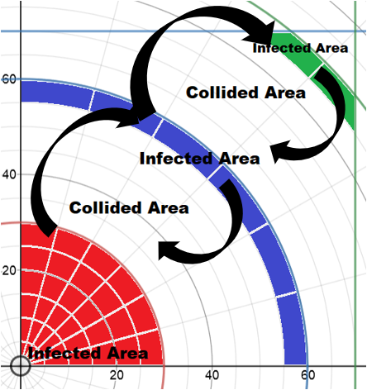
Stress test
Small floor (70x70) with lot of nodes (up to 3100) very hight density
The collapse of the coverage never happens
The message is able to spread even at high densities
Antonio Di Tecco Gabriele Martino Maurizio Pulizzi
5

Slide 6
High density inefficience
For excessive density we have:
Hight number of hops the spread of the message does not take place like wildfire
Hight number of collisions
Hight Broadcast Time
Antonio Di Tecco Gabriele Martino Maurizio Pulizzi
6

Slide 7
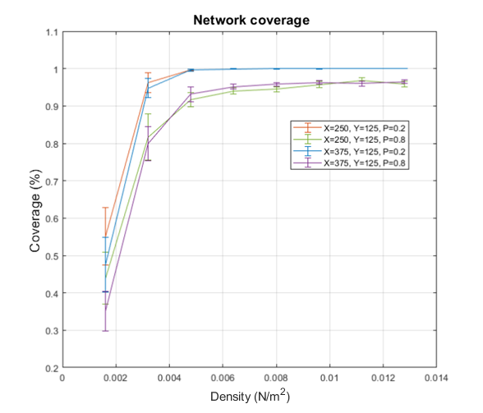
Area and ratio indipendence
For the percentage of coverage we can say that:
the area of the floor has a negligible influence
the shape of the plane has a negligible influence until it becomes too squashed
Antonio Di Tecco Gabriele Martino Maurizio Pulizzi
7

Slide 8
Broadcast time
Rectangular scenario
Decreasing trend for low P
Increasing trend shows inefficiency
0.9 quantile for more stable samples
Fronts of first point reaching high C%
Minimum points of fronts represent the lowest density for the lowest BT for an high C%
Antonio Di Tecco Gabriele Martino Maurizio Pulizzi
8

Slide 9
Broadcast time Dependence on Area and Shape
Probability of retransmission and density fixed to the minimizing point :
P = 0.4 ; б = 0.0064 N/m² (200 nodes on the previous case)
Same ratio between the two edges: 2:1
Incremental Area
Fixed area
Incremental ratio of the two edges: from 1:1 to 1:8
No edges under about 2.5 times the diameter of a coverage area of a node
Antonio Di Tecco Gabriele Martino Maurizio Pulizzi
9

Slide 10
Broadcast time Dependence on Maximum distance
The real dependence is about the distance between the starter node and farthest ones.
Analisys on distance between starter node positioned at center and corners
Antonio Di Tecco Gabriele Martino Maurizio Pulizzi
10

Slide 11
The Highway
The propagation is choked
The position of the starter node matters
A lower P is needed
Antonio Di Tecco Gabriele Martino Maurizio Pulizzi
11

Slide 12


Question?

